Slide 1
PERSUASIVE WRITING
N COATES
2016

Slide 2
The purpose of persuasive writing is to convince the reader that what you say is correct. This type of writing can be used:

Slide 3
When arguing against a particular point of view in order to convince others to accept your argument and conclusion. When trying to convince someone to buy a product. When trying to convince someone to do something. When trying to convince others to share your beliefs or values.

Slide 4
Some genres which require persuasive language are persuasive essays, persuasive letter writing and advertising.
To build a persuasive argument you must:
Establish facts to support your argument
Clarify relevant values.
Ensure that your facts are sequenced in order to build the argument.
Recognise any emotional reactions to the issue.

Slide 5
Let’s have a look at the NAPLAN marking criteria

Slide 6
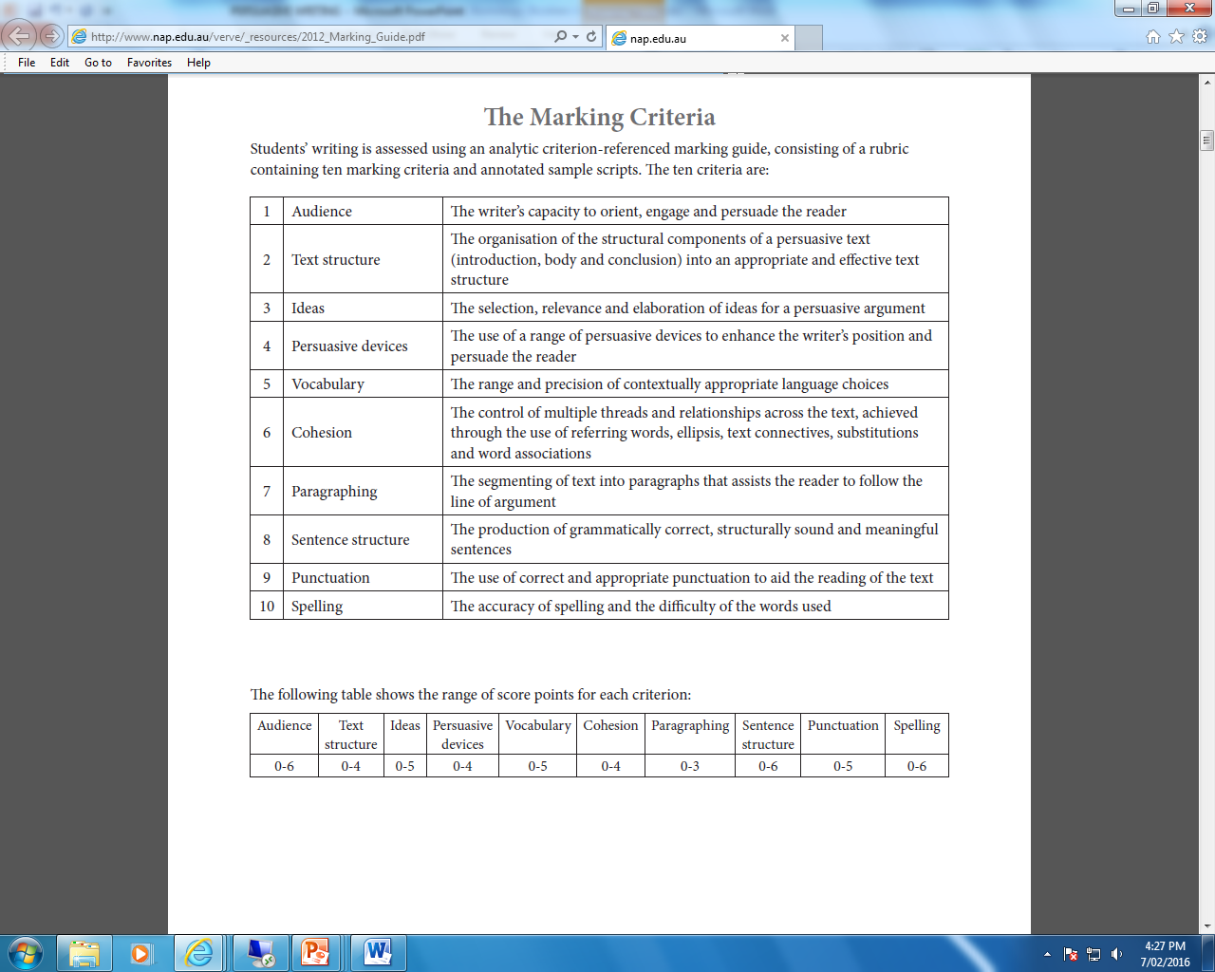
NAPLAN – Marking criteria

Slide 7
Getting started
Consider the topic and list the points for and against.
Decide the which side of the argument you will be able to argue best. It is best if you are able to write in favour of what you believe about a topic as you are more likely to write with conviction and thus be more convincing.
Choose your arguments. It can be a good idea to choose a couple of opposite arguments and to refute (argue against) those in the course of your response.

Slide 8
This is what your planning page should look like
FOR

Slide 9
This is what your planning page should look like
against

Slide 10
Once you are satisfied that you have listed all the arguments for and against and decided which side you are going to defend then are you are ready to plan your writing task. A persuasive essay has three body parts – INTRODUCTION, BODY and CONCLUSION.

Slide 11
INTRODUCTION
In the introduction you state the topic and state the position you are taking. As with other forms of writing it is essential that the introduction attracts the attention of the reader. The reader should get the impression that you have thought about the topic and you know what you believe about it. Here are some suggestions which would help you to achieve this.

Slide 12
1. Start with a question
Have you ever stopped to think what the world would be like if all bird life was extinct?

Slide 13
2. Begin with a quote which supports your argument
“If we continue to pollute the atmosphere with poisons and gases all bird life will be extinct in 50 years,” states South Australia’s chief scientist.

Slide 14
3. Start with a strong statement of your position
Greed not only consumes our environment, it also consumes our animal and bird life.

Slide 15
4. Start with a statistic or a fact which supports your argument
By the year 2020, 50% of all animal and bird life will be extinct.

Slide 16
An introduction could read as follows:
Greed not only consumes our environment, it also consumes our animal and bird life as well. Our unquenchable thirst for new, better and more cars and washing machines and kitchens and houses is created by more and more invasive advertising and fed by companies greedy for more profits. Awareness of environmental destruction is not considered in this race to fulfil our manufactured dreams.

Slide 17
Let’s look back at our common assessment task on gaming. “Computer games make children stupid” Looking at your introduction, how can you now improve it using the techniques provided earlier?

Slide 18
Body
In this part of the task you present your arguments and evidence to support your position. A good plan when you are presenting your arguments is to introduce your strongest argument first but leave your second strongest argument for last. Each point needs to be made concisely in approximately 5 sentences. The first sentence should state the point or reason. Then in 3 or 4 sentences, you should back up the reason with clear and persuasive language. After making the first point, work through your arguments logically. Your goal is to have readers agreeing with you as they read your work.

Slide 19
You can follow this pattern:
Topic sentence (outlines the first supporting argument)
Reason (why you think this is the case)
Evidence (quote a statistic, an expert opinion or a piece of research which supports your claim)
Explanation (explain why this is such a convincing piece of evidence)

Slide 20
Some persuasive techniques
Rhetorical question:
A question that is asked which makes the reader think. How would you feel if you had two hours of homework every night?
Repetition:
Words or phrases are repeated so that they stick in the reader’s mind. Remember what it was like to be at school, remember how much work you had.

Slide 21
Some persuasive techniques
Emotive language:
When words are used to make the reader feel a certain emotion, like sadness or anger. We are the poor, helpless children who are forced to do hours and hours of homework every night.
Exaggeration: When information is given that is over the top or slightly untrue. If I get set one more homework I am going to move to the moon!

Slide 22
Some persuasive techniques
Facts and statistics: When truthful information is given to back up a point. 95% of pupils feel that there is too much homework.
Groups of three: When three adjectives or phrases are used to emphasise a point. Homework is boring, dull and uninteresting.
Comparisons are useful: If readers are able to relate your argument to something they already know to be true then they will be more likely to agree with you, so comparisons are useful.

Slide 23
Homework: Revise your persuasive techniques for a test tomorrow!

Slide 24
TEST – MATCH UP EXERCISE

Slide 25
CONCLUSION
The conclusion will summarise the strongest arguments in a logical way and make a final clear statement of what you want the reader to believe or do.

Slide 26
Let’s have a look at an example essay
“Giving some of your time to working for a charity is a good thing to do”

Slide 27
Your turn to write a persuasive essay
“Every student should visit Canberra”
Your essay should be completed in three lessons
Your essay should be typed
You must hand in the planning, draft and final copy.
You can copy and paste your essay on the S drive – curriculum shared- hand in work – Year 9 – English- Coates 2016
Don’t forget to name your document!
Remember – don’t use: firstly, secondly, thirdly.
Use as many persuasive techniques and connectives as possible. You may use all notes handed in class.

